Slide 1
UVStocks
Trent, Jared, Kyler, David, Josue

Slide 2
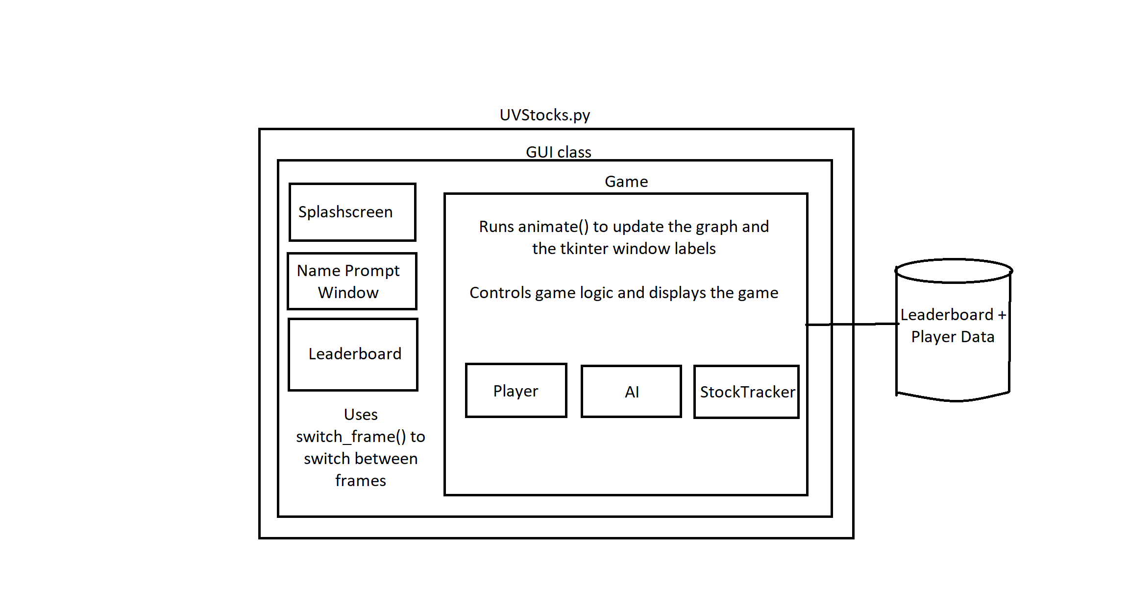

Slide 3
Trent
I learned:
Source control
Architecture for larger(ish) programs
Tkinter
UI Software design and patterns
I did:
Architecture

Slide 4
Josue
I learn:
GitHub
Classes interactions
Large projects
I contribute CSV file
Score updater

Slide 5
Jared
I did the stock price generation
Originally, I used a python generator
Then I switched to using a class to handle this
I learned a lot about python generators
Also learned some cool things about ui design patterns

Slide 6
Kyler
What I learned:
How to use GitHub with a team
How to create a GUI using Tkinter
What I did:
I created the leaderboard
I created the splash screen image
I added error checking to our buy and sell functions

